Slide 1

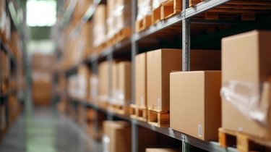



Insert LOGO Here
Delta1st was built for retailers who need speed, control and visibility.
WITHOUT ENTERPRISE COMPLEXITY.
ARE YOU MANAGING INVENTORY, PAYMENTS, AND REPORTING ACROSS MULTIPLE SYSTEMS TODAY?
Providing real-time inventory tracking with barcode scanning, low-stock alerts, and purchase order management. Retailers maintain optimal stock levels, to reduce overstock or stock out situations.
Consolidated reports of sales, payments, taxes, discounts, and returns to reconcile transactions. Retail owners close days faster, reduce errors, and eliminate manual spreadsheets
Streamlined POS workflows, custom menus, barcode scanning, split payments, and mobile or multi-register support speed up checkout. Reducing lines, improving customer experience, and increasing sales during busy periods.
Most POS systems sell payments first. Delta1st was built to run the entire retail store while controlling inventory, margins, and operations.
Other POS Systems
Delta1st
Inventory and payments often require separate modules or third-party apps
POS, inventory tracking, barcode scanning, purchase orders, and payments unified
Limited visibility leads to over-ordering or empty shelves
Real-time inventory visibility reduces stockouts and excess inventory
Slower checkout experiences during peak traffic due to rigid workflows
Streamlined checkout with barcode scanning, mobile POS, and split payments
Manual reconciliation across sales, discounts, taxes, and returns
Built-in reporting and reconciliation eliminates manual spreadsheets
Costs increase as merchants add inventory, reporting, or multi-registers.
Scales with the business without enterprise-level cost or complexity
Insert LOGO Here
Insert Contact Information Here

