Slide 1



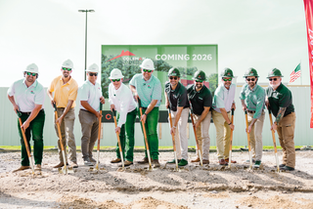


Insert LOGO Here
WAS is a modern acquiring platform that manages the full payment lifecycle, from onboarding and authorization to settlement, funding, and support. Payments stay consistent and reliable as you grow across all channels.
WAS is directly connected to the card networks, providing a stable and consistent payments layer as your business grows.
Merchants often get stuck when POS systems, processors, and gateways pass blame. With WAS owning payments end‑to‑end, from authorization to funding and support, there’s one place to call and faster resolution when it matters most.
Growth shouldn’t disrupt payments. WAS delivers an issuer‑connected acquiring platform that keeps funding, reporting, and support consistent as your business adds locations, volume, or new payment channels.
No more funding surprises or fee confusion. By operating closer to authorization and settlement, WAS delivers predictable funding, clearer reporting, and better visibility into your transactions.
Why Merchant’s Choose WAS
  One Platform for Every Way You Get Paid
Run in-store, online, and omnichannel payments through one unified acquiring platform.
  Clear Funding and Faster Resolution
Know when funds will settle, understand your fees, and resolve issues faster through a single owner of the payment lifecycle.
  Built to Grow Without Disruption
Add locations, increase volume, or expand channels without changing processors or re-working your payments stack.
  Modern, Issuer-Connected Payments
A fintech-built acquiring platform that connects directly to the issuer—reducing dependencies, increasing transparency, and delivering a more reliable payments experience.
Insert LOGO Here
Insert Contact Information Here

